Slide 1

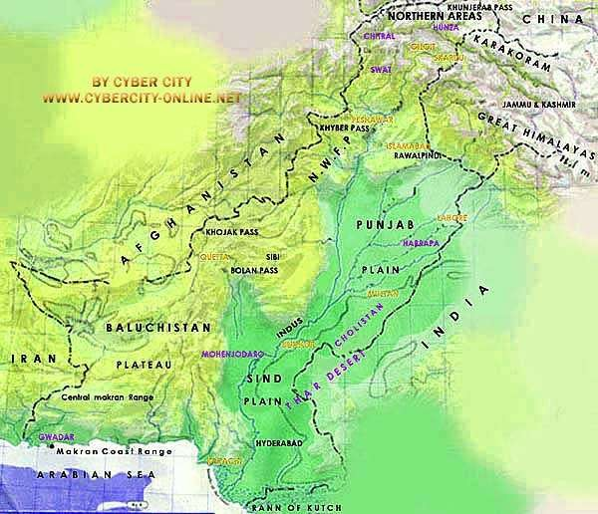
Physical Features of
Pakistan

Slide 2

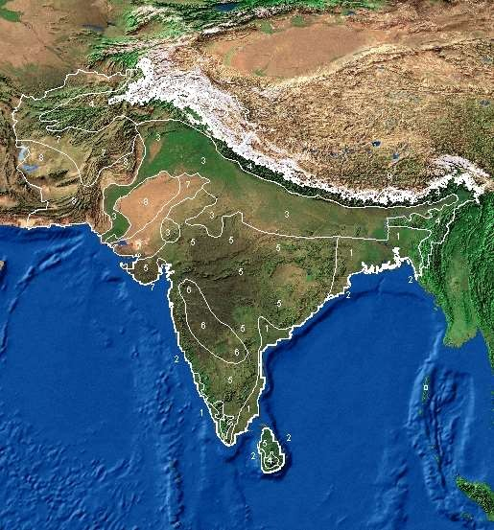
Satellite view of South Asia

Slide 3

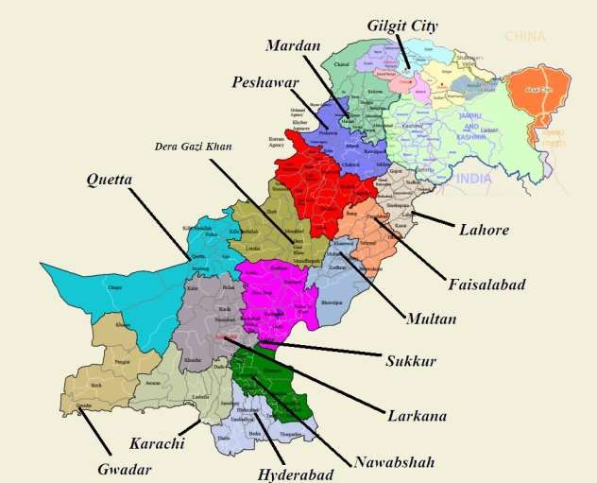
Political Map of Pakistan

Slide 4

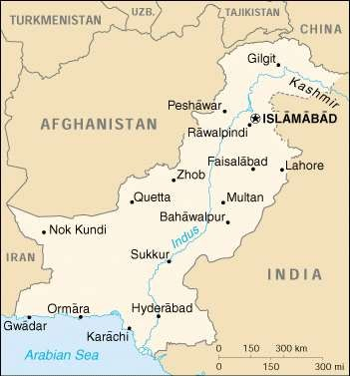
Neighbors of Pakistan
Coordinates:
Latitude:
24° N - 37 °N
Longitude:
61 °E - 75.5 ° E
Total Area:
796,096 sq km
Altitude:
Highest point: K-2 (8611m)
Deepest point:
Dasu patan (6500m) Lowest point:
Sea level 0 (feet)

Slide 5
Immediate Neighbor Countries
Countries
Direction
Length of border (Km)
China
North
592
India
East
1600
Arabian Sea
South
1000
Iran
South West
850
Afghanistan
West
2250

Slide 6

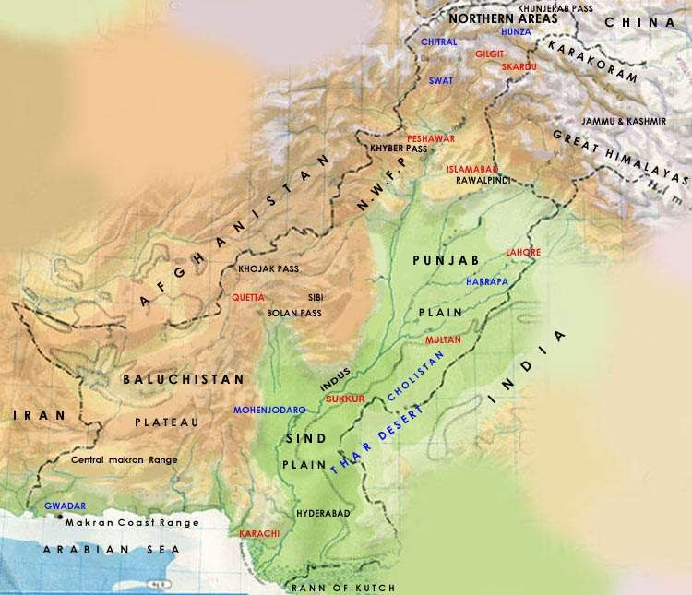
Physical Map of Pakistan

Slide 7
Physical Division of Pakistan
Generally We can classify the Pakistan into Four Major Physical provinces which are:
Mountains
Plains
Plateaus
Deserts

Slide 8

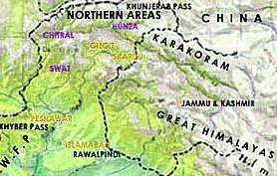
Mountains
There are three distinct Mountain ranges
Northern Mountains
  Karakoram Ranges
  Himalaya Ranges
    Greater Himalayas
    Lesser Himalayas
    Siwaliks
North Western Mountains
  Hindukush
Western Mountains
  Safed Koh Ranges
  Waziristan Hills
  Suleman and Kirthar Range

Slide 9













Northern Mountains
Himalayas:
Sub Himalayas Height: 600-1200 meter
Lesser Himalayas Height: 1800-4600 meter
Great Himalayas Height: more than 4600 meter

Slide 10
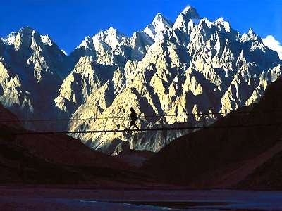
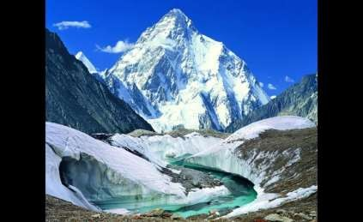
Northern Mountains
Karakorum:
Average height is about 6100 meter Goodwin Austin (K-2) 2nd highest peak

Slide 11
North Western Mountains
Hindu Kush Mountains: Originates from Pamir plateau.
highest peaks are Noshaq (7369 m) and Tirch mir (7690 m)
lies in the west of Himalaya and karakorum

Slide 12
Western Highlands
Western highland comprises of the following three mountain ranges.
The koh-e-sofaid ranges:
  Average height is about 3600 m
  Highest peak is Sikaram (4700 m)
  Located in East-West Direction
  Kurram and Kohat valley lies in this range.

Slide 13
Western Highlands
Waziristan hills:
Located between Gomal and Kurram river.
Its Height ranges from 1500 - 3000 meter.
These range forms the border between Afghanistan and Pakistan
Famous Khyber pass lies in this Range.

Slide 14




























Western Highlands
The Suleman and Kirthar Ranges:
1.
2.
Starts from South of Gomal River
Lies between the Baluchistan plateau and the Indus river.
Average height is about 600 m.
Takht-e-Suleman is the highest point (3487
m)
In south The Suleman joins the kirthar range. And Kirthar merges into the kohistan area of
Sindh.
3.
4.
5.
6.

Slide 15
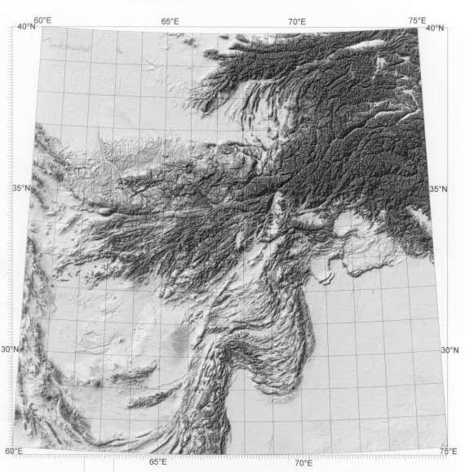
The Suleman and Kirthar Ranges:
Here We can see the Releif of Suleman and Kirthar range

Slide 16
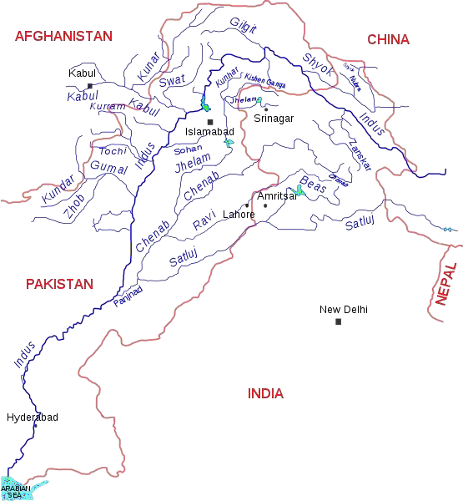
The Indus Plains

Slide 17
The Indus Plains
The Whole Indus plain comprises the 20% of the Pakistan.
We can divide it into three parts;
  Upper Indus Plain
  Lower Indus Plain
  Deltaic Plain

Slide 18
The Indus Plains
The Upper Indus Plains:
  Extends from Attock to Mithan kot.
  Jhelum, Chenab, Ravi and Sutlej are the Eastern tributaries of river Indus.
  The area between the two tributaries is called Doab.
  All the tributaries meet at the point called Panjnad.
Name of Doab | Name of Rivers
Bari Doab | River Beas & River Ravi
Rachna Doab | River Ravi & River Chenab
Chaj Doab | River Chenab & River Jhelum
Sindh Sagar Doab | River Jhelum & River Indus

Slide 19
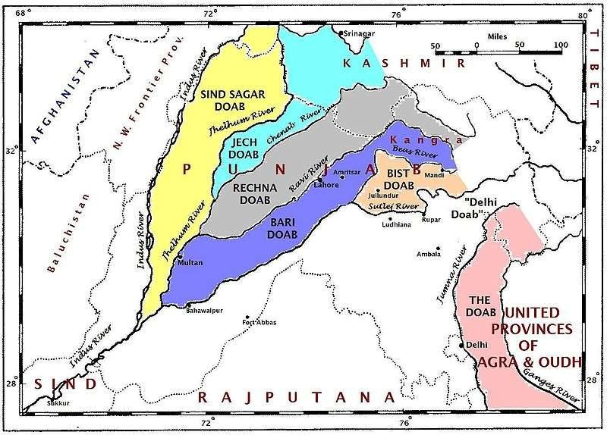
The Indus Plains

Slide 20
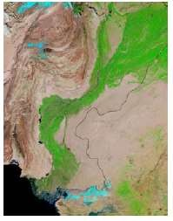
The Indus Plains
The Lower Indus Plains:
  It extends from Mithan kot to Thatta.
  This is the old stage of river Indus.
  Due to the very less gradient speed of Indus is very slow.

Slide 21
The Indus Plains
The Deltaic Plain:
  Total length is 1000 km
    While 700 Km lies in Baluchistan
    And about 300 km lies in Sind.
  Thatta and Badin districts in Sind.\
  Mangrove forests are the significant feature of the Sind Deltaic plain.
  The coastal area lies in Baluchistan is called makran coastal plain.

Slide 22
Deserts of Pakistan
Deserts in Pakistan
Thar
Thal
Cholistan
Kharan

Slide 23
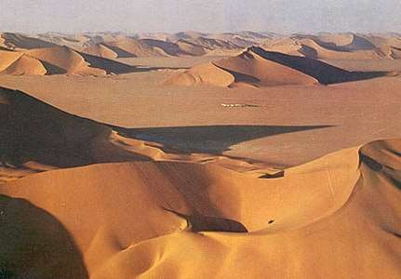
Deserts of Pakistan
Thar Desert:
  This desert lies in the South east of Pakistan.
  This desert is the extension of Rajasthan desert of India.
  The Section of this desert situated in the Bahawalpur division
is called Cholistan.

Slide 24
Deserts of Pakistan
Thal Desert:
  Thal desert lies between the River Indus and Jhelum.
Kharan Desert:
  The Kharan desert located in the North west Baluchistan.
  The average rainfall is less than 100 mm.

Slide 26
The Plateaus of Pakistan
Plateaus of Pakistan
Baluchistan Plateau
Potowar Plateau and Salt Range

Slide 27
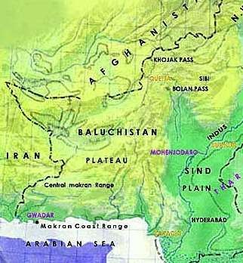
The Plateaus of Pakistan
The Baluchistan Plateau:
Located in Southwest of Pakistan.
Average height is about 300 – 600 meters.
Very rich in mineral
resources.
Scanty Rain fall. Inland drainage.

Slide 28
The Plateaus of Pakistan
The Potwar Plateau & The Salt Range:
1.
2.
3.
Located between River Indus & River Jhelum Height 300 to 600 meters from sea level.
Soan River is main river. It forms gullies and large alluvial plains, mainly used for agriculture.
Rich in minerals like rock salt, gypsum, lime stone, coal, marble, clays, dolomite & soapstone and oil.
While average height of Salt range is 750 to 900m.
Sakesar Peak is the highest point in the Salt Range at a height of 1527m.
4.
5.
6.

Slide 29
Thank You
Source:- linkedin/slideshare

